Slide 1
DATA WAREHOUSING
BY Suhas Kumar(CT13897),Abhyanth P(CT13962)

Slide 2
WHAT IS DATA WAREHOUSING
A Data Warehousing (DW) is process for collecting and managing data from varied sources to provide meaningful business insights.
A Data warehouse is typically used to connect and analyse business data from heterogeneous sources.
It is a blend of technologies and components which aids the strategic use of data.
It is electronic storage of a large amount of information by a business which is designed for query and analysis instead of transaction processing.
It is a process of transforming data into information and making it available to users in a timely manner to make a difference

Slide 3
CHARACTERSTICS OF DATA WAREHOUSING
Subject oriented->A data warehouse is subject-oriented, as it provides information on a topic rather than the ongoing operations of organizations
Integrated->Integration in Data Warehouse means establishing a standard unit of measurement from the different databases for all the similar data.
Time-variant->Compared to operating systems, the time horizon for the data warehouse is quite extensive. The data collected in a data warehouse is acknowledged over a given period and provides historical information.
Non-volatile-> The data warehouse is non-volatile, meaning that prior data will not be erased when new data are entered into it. Data is read-only, only updated regularly. It also assists in analysing historical data and in understanding what and when it happened.

Slide 4
DATA WAREHOUSE VS DATA MART
Data Warehouse is a large repository of data collected from different sources whereas Data Mart is only subtype of a data warehouse.
Data Warehouse is focused on all departments in an organization whereas Data Mart focuses on a specific group.
Data Warehouse designing process is complicated whereas the Data Mart process is easy to design.
Data Warehouse takes a long time for data handling whereas Data Mart takes a short time for data handling.
Comparing Data Warehouse vs Data Mart, Data Warehouse size range is 100 GB to 1 TB+ whereas Data Mart size is less than 100 GB.
When we differentiate Data Warehouse and Data Mart, Data Warehouse implementation process takes 1 month to 1 year whereas Data Mart takes a few months to complete the implementation process.

Slide 5
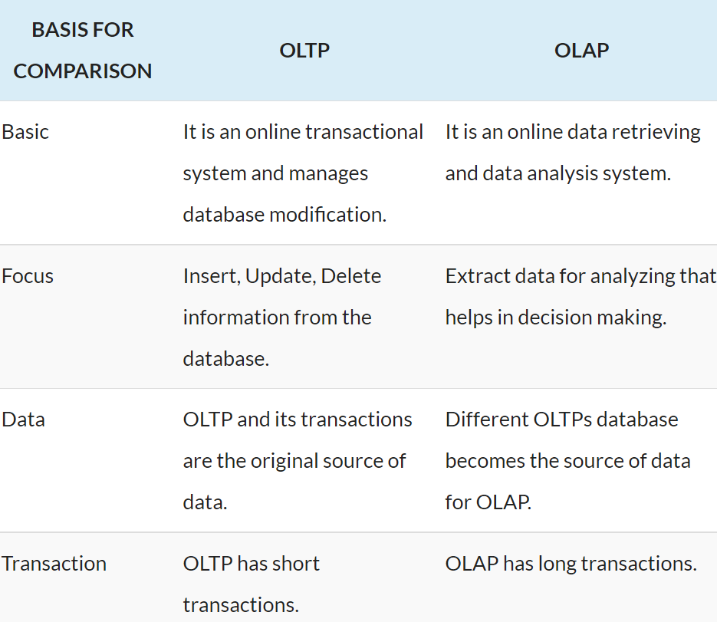
OLTP VS OLAP

Slide 6
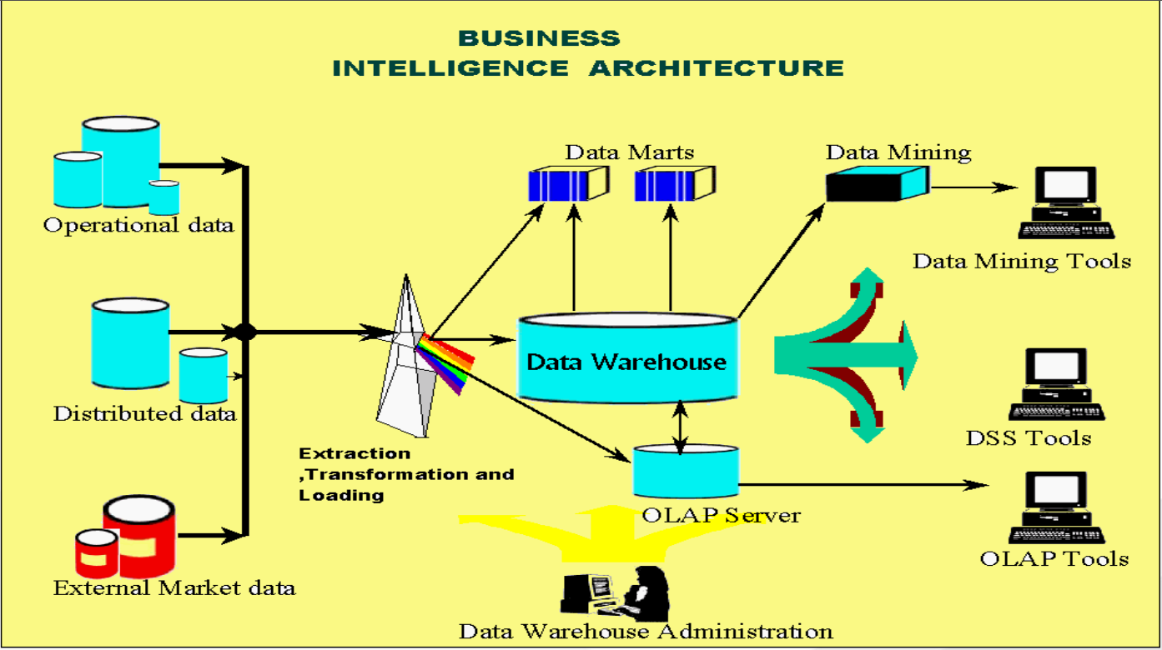
BUISNESS INTELLIGENCE LIFE CYCLE

Slide 7
TYPES OF FACTS
Additive->Additive facts are facts that can be summed up through all of the dimensions in the fact table. A sales fact is a good example for additive fact.
Semi-Additive->Semi-additive facts are facts that can be summed up for some of the dimensions in the fact table, but not the others-> Daily balances fact can be summed up through the customers dimension but not through the time dimension.
Non-Additive: Non-additive facts are facts that cannot be summed up for any of the dimensions present in the fact tableted: Facts which have percentages, ratios calculated.
Fact less Fact Table->In the real world, it is possible to have a fact table that contains no measures or facts. These tables are called “Fact less Fact tables". Egg: A fact table which has only product key and date key is a fact less fact.

Slide 8
DIMENSIONS
Rapidly Changing Dimensions: The Dimension which contains rapidly changing attributes. If we maintain any historical data for these type of tables. We will definitely get an issue related to memory and performance. The solution is to maintain mini dimension tables for historical data like type 4 Dimension in SCD.
Junk Dimensions: In the data warehouse design we will come across a situation to use flag values. We can use one single table for this so that in Fact table no need to have multiple columns to store the Primary key values of these flag table
Conformed Dimensions: Dimensions which are connected with multiple fact tables are know as conformed Dimension.

Slide 9
EXAMPLE OF TYPE 2 SCD
In order to support type 2 , we need to add four columns to our table:
Surrogate Key – the original ID will no longer be sufficient to identify the specific record we require, we therefore need to create a new ID that the fact records can join to specifically.
Current Flag – A quick method of returning only the current version of each record
Start Date – The date from which the specific historical version is active
End Date – The date to which the specific historical version record is active

